Slide 1
CAPSTONE PROJECT FINAL PRESENTATION
Empowering Community Lending
A Predictive Credit Risk Analytics Framework for the
Canadian Credit Union Association (CCUA)
BIA-5450-0LA | Professor Raed Karim
GROUP 4
Aakarshan Gupta
Darren Fernandes
Mohammed Faisal Khan
Alin Inayat Maknojia
Omar Mansour
Tousif Ibrahim Patel

Slide 2
BUSINESS PROBLEM
The Challenge: Better Credit Decisions Before Capital Is Deployed
BUSINESS CONSEQUENCE
CURRENT CHALLENGE
OPPORTUNITY
Traditional Credit Assessment
TYPE I ERROR
Predictive Risk Intelligence
Creditworthy applicant rejected
Static historical credit scores
Rigid approval thresholds
Limited ability to capture interactions between borrower financial characteristics
Impact: Lost lending and member-growth opportunity
Combine borrower financial characteristics to identify risk before credit is extended.
TYPE II ERROR
High-risk applicant approved
Impact: Default and direct capital erosion
Protect cooperative capital while supporting more consistent lending decisions.
CCUA — Predictive Credit Risk Analytics
2

Slide 3
ANALYTICS QUESTIONS
From Portfolio Visibility to Prescriptive Decisions
DESCRIPTIVE
DIAGNOSTIC
PREDICTIVE
PRESCRIPTIVE
What is happening?
Why is it happening?
What is likely to happen?
What should CCUA do?
What is the historical default rate?
Which loan categories show the highest risk?
Which borrower characteristics distinguish higher-risk segments?
How do employment stability, DTI and revolving utilization relate to outcomes?
Which applicants are likely to default?
How much capital may be exposed?
Which applications require additional review?
When should compensatory terms or denial be considered?
How should capital-risk exposure influence decisions?
20 analytical questions guided the project across the four analytics levels.
CCUA — Predictive Credit Risk Analytics
3

Slide 4
PROJECT SCOPE
Project Scope: From Historical Lending Data to Decision Support
IN SCOPE
DELIVERABLES
DATA PREPARATION
1
2
Historical personal and retail lending data
Clean Analytical Dataset & SQLite Framework
Predictive Default-Risk Model
RISK ANALYTICS
Borrower and portfolio risk analysis
PREDICTIVE MODELLING
3
4
Default-risk classification
10-Sprint Power BI Dashboard Suite
Underwriting Decision-Support Insights
BUSINESS INTELLIGENCE
Power BI executive dashboards
OUT OF SCOPE: Production deployment • Fraud detection • Corporate lending • Direct collections management
CCUA — Predictive Credit Risk Analytics
4

Slide 5
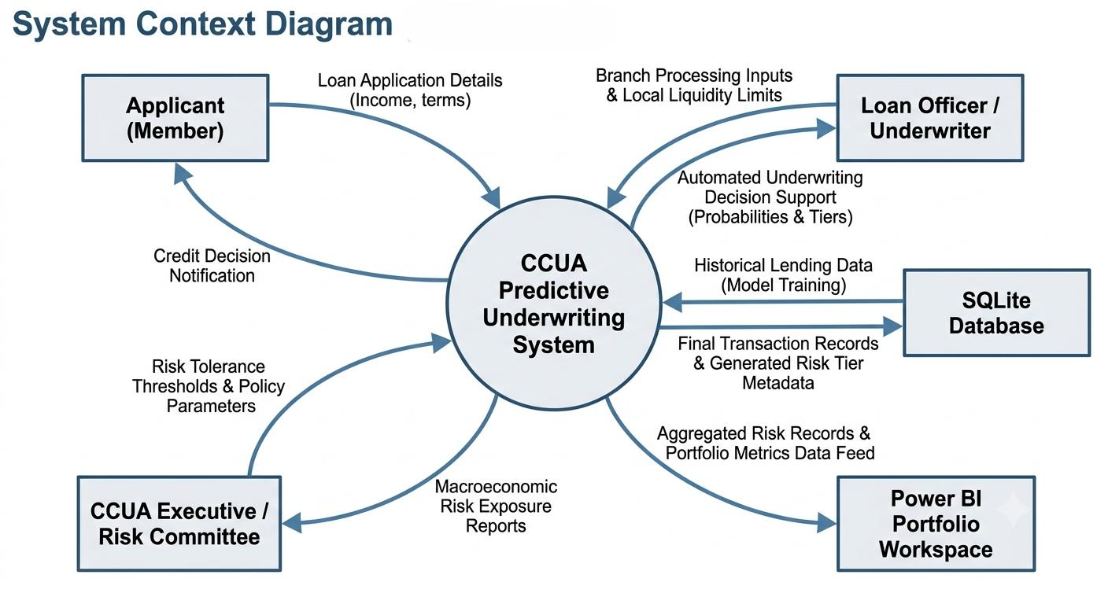
DATA SOURCES, ENTITIES & FLOW
2.26 Million Loan Records Formed the Analytical Foundation
2,260,668
145
Anonymized
Historical Loan Records
Raw Variables
Source Dataset
BORROWER
LOAN ACCOUNT
CREDIT BEHAVIOUR
LOAN OUTCOME
Income
Employment
Home Ownership
Loan Amount
Term
Interest Rate
Purpose
DTI
Revolving Utilization
Delinquencies
Credit Inquiries
Fully Paid
Charged Off / Default
CCUA — Predictive Credit Risk Analytics
5

Slide 6
DATA PREPARATION & OUTPUT
Turning Raw Lending Data into a Model-Ready Risk Dataset
RAW DATA
CLEAN & STANDARDIZE
PREVENT TARGET LEAKAGE
CREATE BINARY TARGET
MODEL-READY DATA
2,260,668 records
145 variables
Missing values
Data types
Duplicates
Outliers
Remove post-origination variables unavailable at application time
Fully Paid = 0
Charged Off / Default = 1
1,303,638 completed loans
1,042,910
260,728
80 / 20
4 : 1
Training Records
Testing Records
Stratified Split
Paid-to-Default Class Imbalance
Active and unresolved loans were excluded from model training because their final repayment outcomes were not yet known.
Note: The model-training population differs from the broader portfolio population used for Power BI analysis. The overall historical portfolio default rate is 40.68%.
CCUA — Predictive Credit Risk Analytics
6

Slide 7
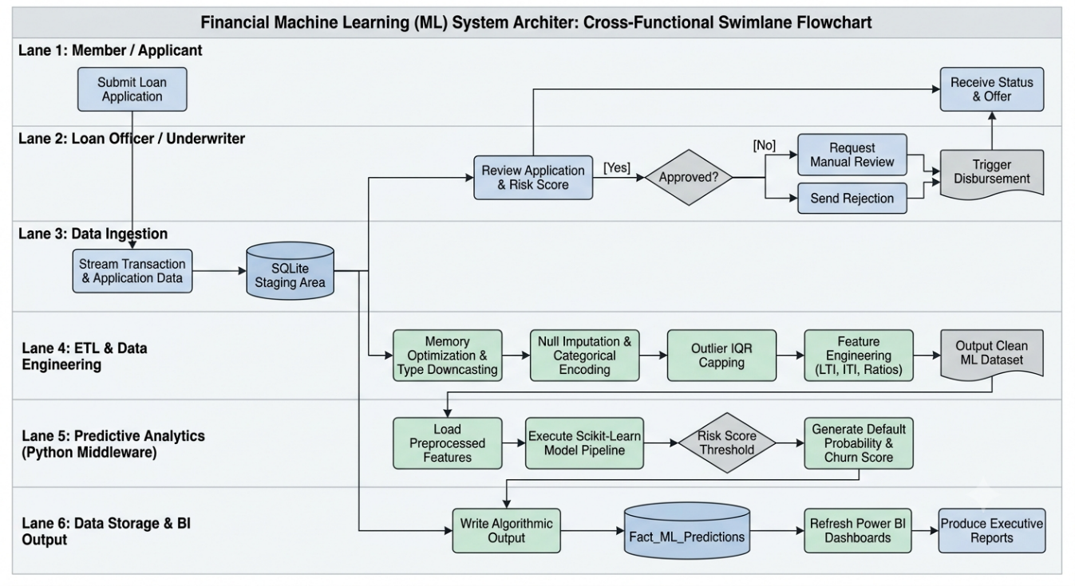
SOLUTION DESIGN
An End-to-End Predictive Credit Risk Analytics Framework
1. DATA INGESTION
Historical Lending Dataset
RISK CLASSIFICATION OUTPUT
LOW RISK
Streamlined automated approval
2. DATA ENGINEERING
Python • Pandas / NumPy • Cleaning & Feature Engineering
0.00–<0.35
MEDIUM RISK
Conditional approval / compensatory terms
3. PREDICTIVE ANALYTICS
Scikit-Learn • Binary Classification • Default Probability
0.35–<0.60
HIGH RISK
Senior-underwriter review
4. DATA STORAGE
SQLite • Cleaned Data • Predictions • Risk Metadata
0.60–0.70
CRITICAL RISK
Automated denial
5. BUSINESS INTELLIGENCE
Power BI • Portfolio Monitoring • Risk Segmentation • Executive Decision Support
≥ 0.70
CCUA — Predictive Credit Risk Analytics
7

Slide 8
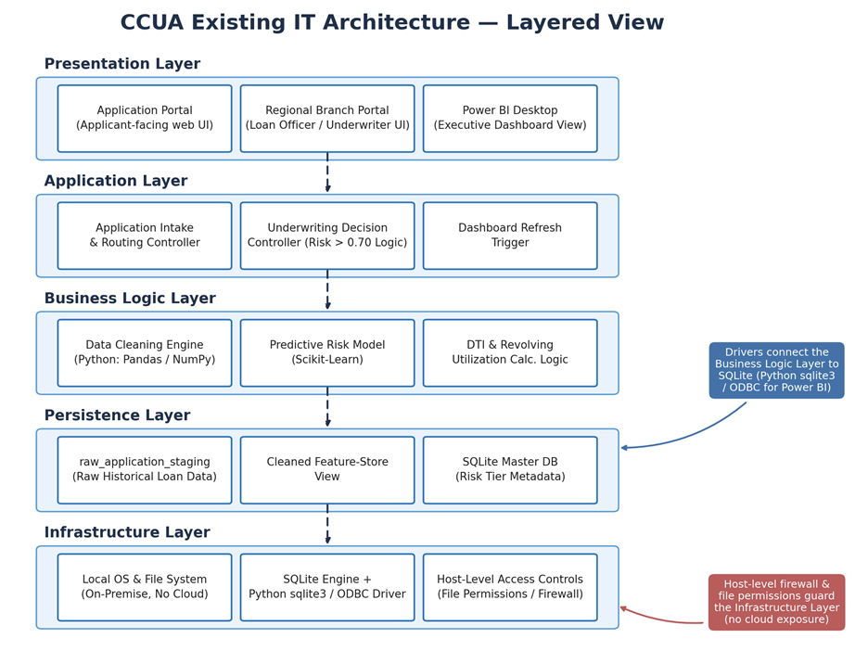
FIT WITH EXISTING IT ARCHITECTURE
Designed to Enhance, Not To Replace the Existing Environment
EXISTING ENVIRONMENT
ADDED INTELLIGENCE
Historical Lending Dataset
Automated ETL
SQLite
Predictive Risk Model
Incremental integration, no major infrastructure replacement required
Python
Risk Scores & Metadata
Power BI Desktop
Enhanced Power BI Analytics
Loan Officers / Decision Makers
Standardized Underwriting Support
LOW COST
PRIVACY
MODULAR
SCALABLE
Open-source analytical stack
Local processing
Components can be upgraded independently
Future enterprise database and Power BI Service migration
CCUA — Predictive Credit Risk Analytics
8

Slide 9
SOLUTION IMPLEMENTATION
10 Agile Sprints Moved the Solution from Baseline Risk to Executive Action
PHASE 1 — UNDERSTAND PORTFOLIO RISK
1
Portfolio Risk Baseline
2
Borrower Stability & Employment
3
Loan Term, Pricing & Payment Burden
PHASE 2 — DIAGNOSE CREDIT STRESS
4
DTI & Credit Stress
5
Credit History & Borrower Segmentation
PHASE 3 — QUANTIFY & PREDICT RISK
6
Capital at Risk
7
Leading Indicators
8
Machine-Learning Risk Tiers
PHASE 4 — TURN INSIGHT INTO ACTION
9
Policy Rules & Underwriting
10
Capital Reserve & Portfolio Optimization
Sprint Planning
→
Backlog Refinement & Data Prep
→
Sprint Execution
→
Sprint Review & Demo
→
Sprint Retrospective & Docs
Each sprint answered a defined analytical question and produced a corresponding Power BI analytical view.
CCUA — Predictive Credit Risk Analytics
9

Slide 10
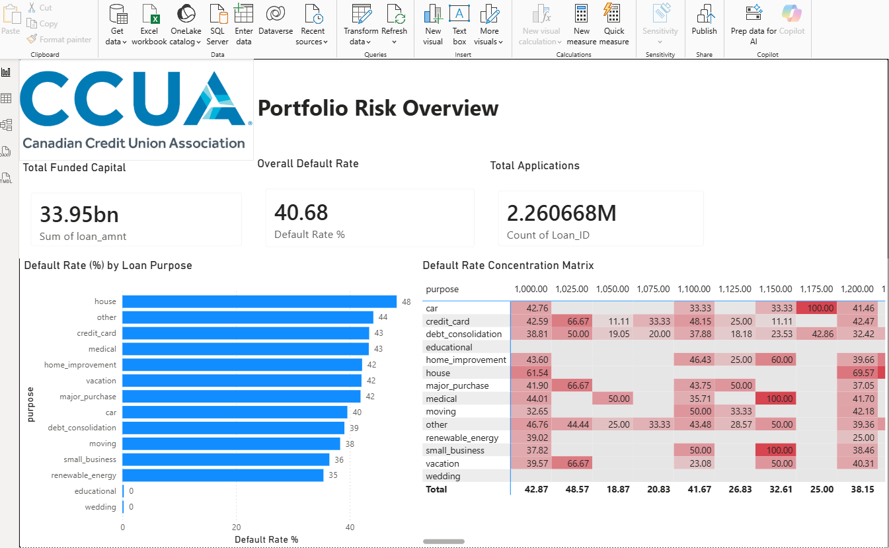
EXECUTIVE PORTFOLIO RESULTS
Portfolio Analysis Revealed Significant and Uneven Credit-Risk Exposure
$33.95B
2.26M
40.68%
$10.05B
Total Funded Capital
Loan Applications
Overall Historical Default Rate
Outstanding Principal
DEFAULT RATE BY LOAN PURPOSE
Executive takeaway: Default risk was not evenly distributed across loan purposes, supporting more targeted underwriting and portfolio monitoring.
These portfolio figures are explicitly reported in the submitted report.
10

Slide 11
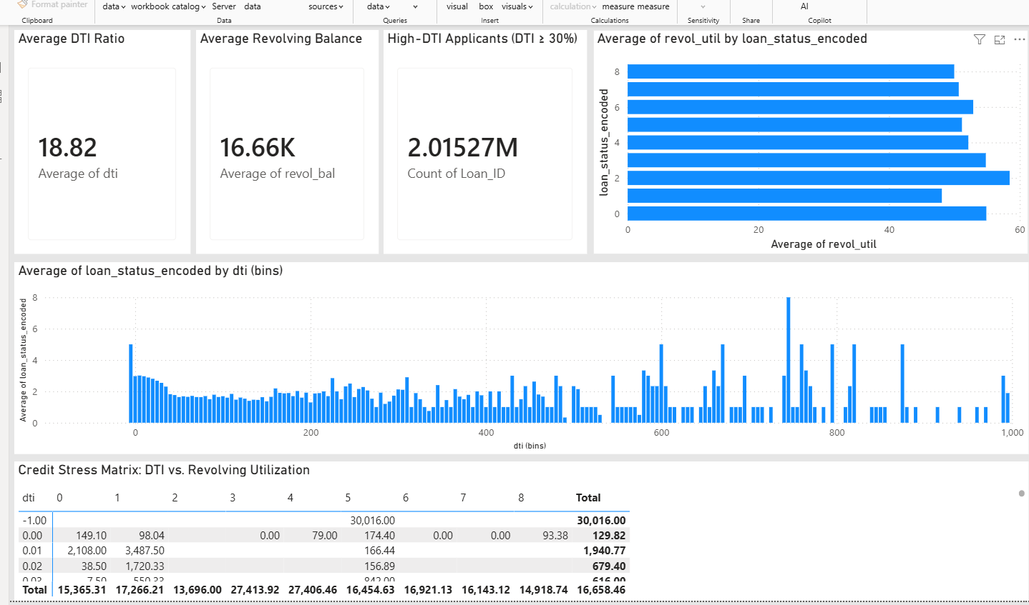

BORROWER & CREDIT-STRESS RESULTS
Borrower Stability and Credit Stress Added Important Risk Signals
EMPLOYMENT STABILITY
HOUSING PROFILE
CREDIT STRESS
46.61%
49.16%
39.59%
18.82%
Average DTI
Mortgage
Rent
~$16.66K
Average Revolving Balance
Highest observed default rate for unverified employment tenure
~2.02M
Applicants with DTI ≥ 30%
Mortgage holders generally demonstrated lower default rates than renters and non-standard housing categories.
Debt burden and revolving-credit behaviour provided additional borrower-risk signals.
Short or unverified employment history represented elevated borrower risk.
Secondary signal: ~60% revolving utilization for Status Code 2, versus ~48% for Status Code 1.
Executive takeaway: Risk was better understood by combining borrower stability, leverage, and
credit behaviour rather than relying on one characteristic alone.
All borrower and credit-stress values appear in the final report.
11

Slide 12
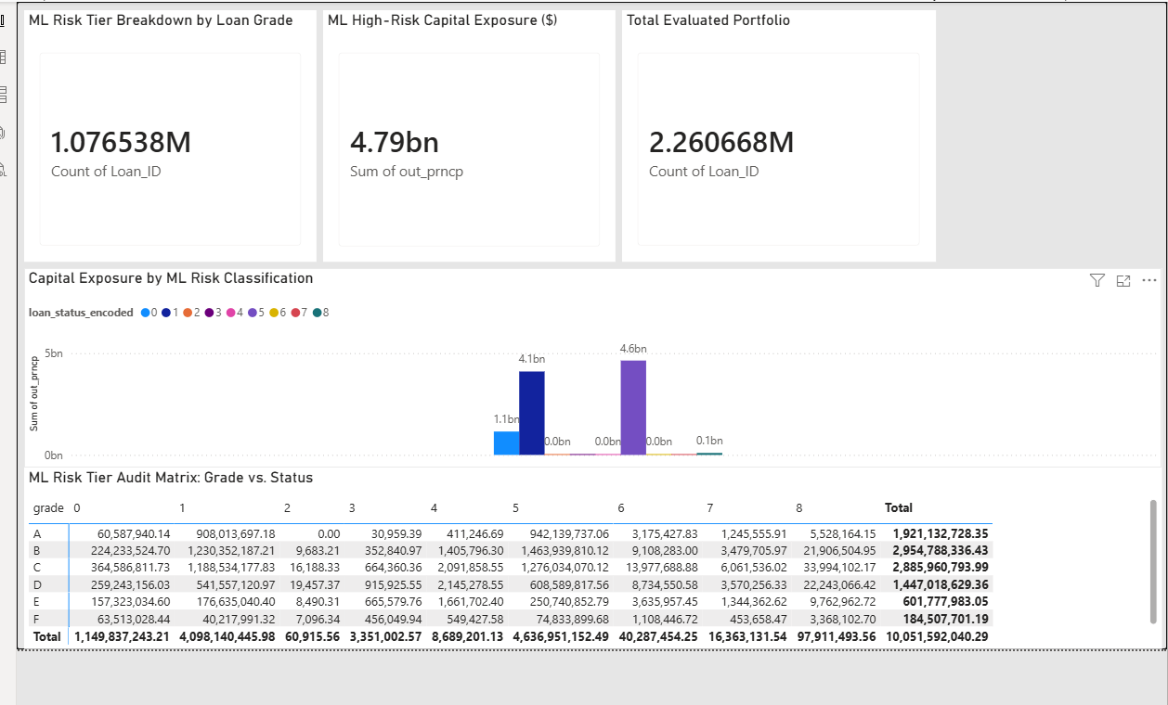
PREDICTIVE RISK & CAPITAL EXPOSURE
Predictive Risk Intelligence Connected Borrower Risk to Capital Exposure
$4.79B
~1.08M
$10.05B
Principal associated with high-risk classifications
High-Risk Accounts
Total Outstanding Principal
CAPITAL EXPOSURE BY LOAN GRADE
RISK-TO-ACTION FRAMEWORK
LOW
MEDIUM
Streamlined Approval
Conditional Approval / Compensatory Terms
HIGH
CRITICAL
Senior Underwriter Review
Automated Denial
Executive takeaway: The framework connected borrower-risk classifications to financial exposure
and actionable underwriting decisions.
The final report documents ~1.077M accounts and $4.79B in high-risk exposure.
12

Slide 13
End-to-End Testing Confirmed Prototype Readiness
The developed solution was validated across data, modelling, reporting, and security layers
TS_01 — Database Connection & Staging Stability
LIVE POWER BI DEMONSTRATION
✓
PASS
Priority: High • Test Cases: 3
12 / 12 Test Cases
TS_02 — Model Inference & Classification Logic
PASSED
✓
PASS
Priority: High • Test Cases: 4
TS_03 — Power BI Visual Integration & Data Refresh
✓
PASS
Priority: Medium • Test Cases: 3
TS_04 — Local OS Security & Access Controls
Validation Areas
✓
PASS
Priority: Medium • Test Cases: 2
Data
→
Model
→
Power BI
→
Security
Result: The prototype operated successfully across the complete analytical pipeline
3 + 4 + 3 + 2 = 12 test cases, with all four scenarios marked Pass.
13

Slide 14
POTENTIAL SOLUTION OPTIMIZATION
A Practical Path from Prototype to Production
NOW — VALIDATE
NEXT — EXPAND
SCALE — INDUSTRIALIZE
Model & Threshold Tuning
Data & Intelligence
Infrastructure & Governance
Recalibrate 0.35 / 0.60 / 0.70 thresholds using real approval and repayment outcomes
Benchmark ensemble methods such as Random Forest and Gradient Boosting
Expand cross-validation and hyperparameter testing
Incorporate regional unemployment
Incorporate interest-rate trends
Establish formal data-sharing agreements with member credit unions
Enable repeat-borrower and longitudinal risk analysis
Migrate SQLite toward enterprise database infrastructure
Publish dashboards through Power BI Service
Implement role-based access control
Add model-performance monitoring
Introduce incremental ETL
VALIDATE → EXPAND → SCALE
The prototype demonstrates feasibility; production deployment should proceed through controlled validation rather than immediate full-scale rollout.
These optimization items are documented in the submitted final report.
14

Slide 15
EXECUTIVE TAKEAWAY
Protecting Cooperative Capital Through Better Risk Intelligence
SEE RISK EARLIER
QUANTIFY EXPOSURE
ACT CONSISTENTLY
Move beyond static historical scoring toward predictive borrower-risk intelligence.
Connect borrower risk to the capital potentially exposed.
Provide member credit unions with standardized risk tiers and underwriting decision support.
The prototype demonstrates a practical, explainable and auditable path for transforming historical lending data into actionable credit-risk intelligence.
PRIMARY DATA SOURCE Kan, W. (2019). Lending Club loan data [Data set]. Kaggle.
CORE PROJECT TECHNOLOGIES Python • Pandas • NumPy • Scikit-Learn • SQLite • Power BI
Thank You
Questions

